Slide 1
Movies Rating Prediction
By Dolev Jimmy

Slide 2
Table of Contents
01
Task Definition
02
Acquiring Data
03
Data processing & EDA
04
Models
05
Evaluation

Slide 3
Task Definition
IMDB Rating:
IMDB is one of the greatest website for movie reviews. As part of its services, it gives a quality-score for almost every movie. This score is known as IMDB rating.
Research question:
Can we estimate movie ratings by examine their attributes?
What effects most on the quality. e.g., what is the relation between movie-genres and their ratings?

Slide 4

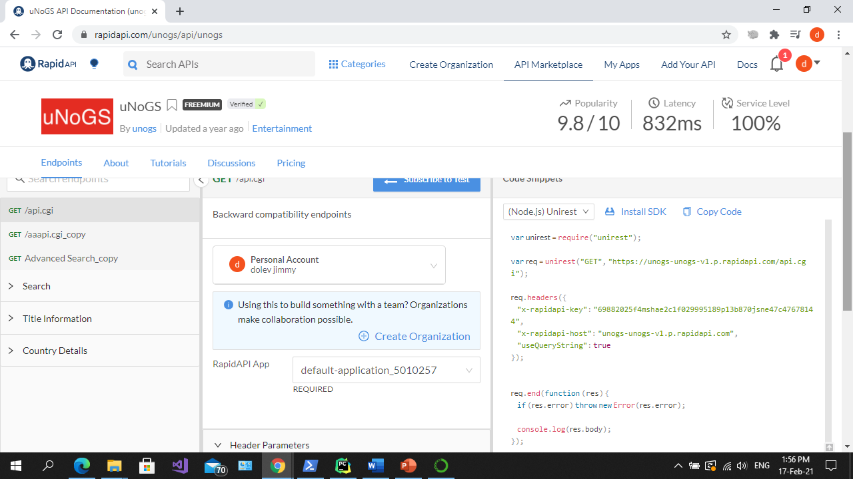
Data source
API
https://rapidapi.com/unogs/api/unogs

Slide 5

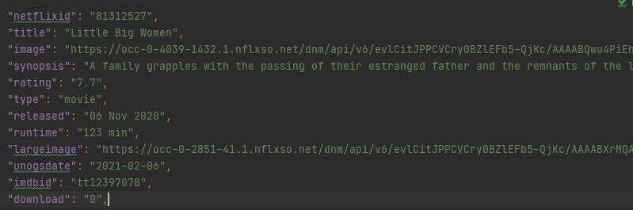
Acquiring data
Using Rapid-API platform I created movie dataset. The raw data acquired was saved in a binary pickle files.

Slide 6

Acquiring data
I added a new features:
experience actor
experience _creator
Experience actor is an actor that played at least 5 movies.
Experienced creator is a creator who has made at least 3 films

Slide 7
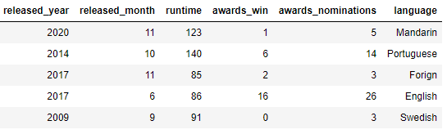
Acquiring data
After Acquiring the data, I transformed it into two csv files: features and labels. Those files contains only relevant information:

Slide 8
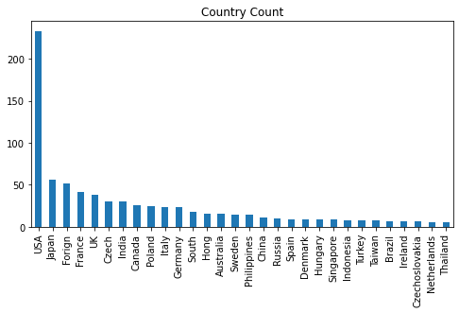
Data processing
In this diagram we see how many movies there are in each country.
The country foreign is all the countries that appeares in up to 5 movies

Slide 9
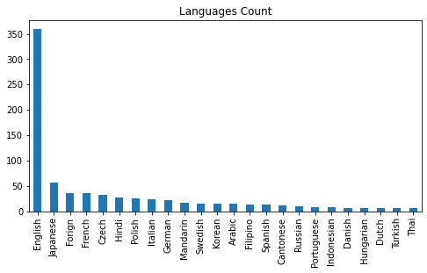
Data processing
In this diagram it can be seen that the languages English and Chinese are the most common.
To predict the ratings more effectively I have combined all the languages that appear in 5 movies and below as a foreign language

Slide 10
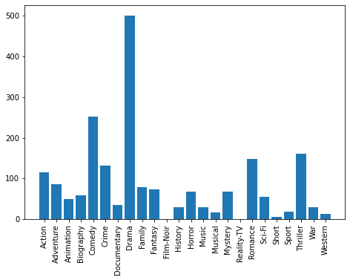
EDA
This diagram describes the number of movies there are from each genre.
It can be seen that the genres drama and comedy are very common
The genres Film-Noir, Reality-TV, Short have low variance so we will remove them to prevent overfitting.

Slide 11
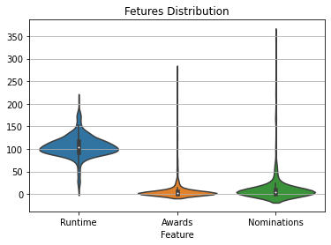
EDA
In this diagram it can be seen that most of the movies are around 100 minutes.
And few movies are nominated and rewarded

Slide 12
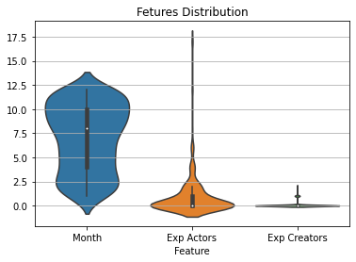
EDA
In this diagram we see the number of films produced each month, the number of experienced actors and the number of experienced directors

Slide 13
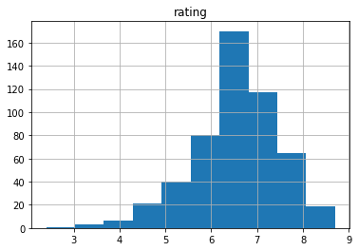
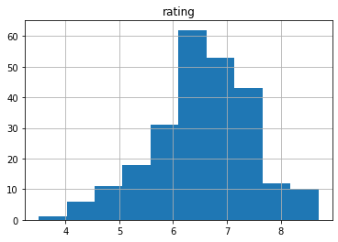
Models
train
For the start we will split the data to train and test
Train= 70%
Test=30%
Then check that train and test has the same distribution
test

Slide 14
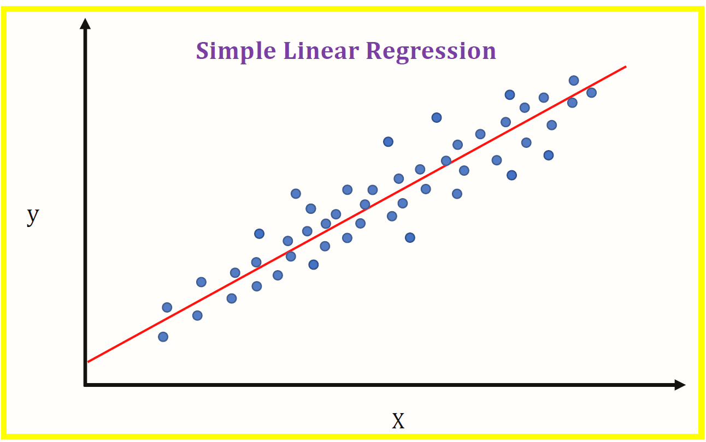
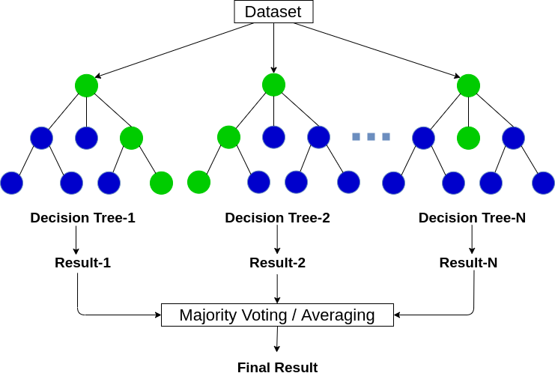
Models
Random Forest
Linear Regression
Random forests or random decision forests are an ensemble learning method for classification, regression and other tasks that operate by constructing a multitude of decision trees at training time and outputting the class that is the mode of the classes (classification) or mean/average prediction (regression) of the individual trees
Simple Portfolio
Presentation
In statistics, linear regression is a linear approach to modelling the relationship between a scalar response and one or more explanatory variables.
You can simply impress your audience and add a unique zing and appeal to your Presentations. Easy to change colors, photos and Text. Get a modern PowerPoint Presentation that is beautifully designed.

Slide 15


Models
The prediction results of the models random forest and linear regression against the IMDB rating
Simple Portfolio
Presentation
Label
Prediction
Random Forest
212 | 8.000000 | 8.005000
You can simply impress your audience and add a unique zing and appeal to your Presentations. Easy to change colors, photos and Text. Get a modern PowerPoint Presentation that is beautifully designed.
Linear Regression
212 | 8.000000 | 9.134830
Random Forest
205 | 7.200000 | 7.040000
Linear Regression
205 | 7.200000 | 7.071311

Slide 16
Evaluation
The 10 features that have the highest impact on the ratings
We can see that 'award_win' is the most influential feature on rating prediction.
In addition, it can be seen that The feature we created ‘num_experienced_actors’
is in 8th place
 | Feature | Importance
0 | awards_win | 0.208180
1 | runtime | 0.120200
2 | released_year | 0.119580
3 | awards_nominations | 0.072590
4 | released_month | 0.054020
5 | Documentary | 0.041960
6 | Drama | 0.038620
7 | Animation | 0.035240
8 | num_experienced_actors | 0.027560
9 | country_Turkey | 0.020040
32%
24%
18%

Slide 17
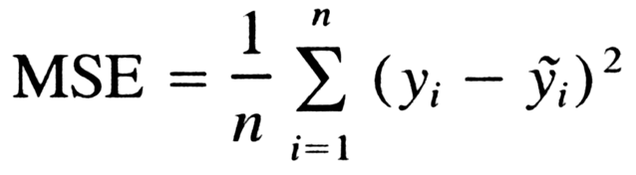


Models
MSE:
In statistics, the mean squared error or mean squared deviation of an estimator measures the average of the squares of the errors—that is, the average squared difference between the estimated values and the actual value
Linear Regression:
You can simply impress your audience and add a unique zing and appeal to your Presentations. Easy to change colors, photos and Text. Get a modern PowerPoint Presentation that is beautifully designed.
Random Forest:n

Slide 18
THANK YOU

